Slide 1
ALD Process for Top-Gating 2D Materials ENGR241 Autumn
Akash Levy, Jung-Soo Ko
Mentors: J. Provine, Michelle Rincon, Vijay Narasimhan

Slide 2
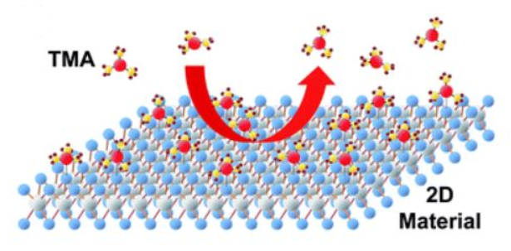
Recap
Uniform and full coverage of high-k gate dielectrics on MoS2
Essential for top-gated 2D device structure
No recipe exists in SNF for depositing high-k on 2D
Only alumina has been tried from ALD tool in Pop lab (not in SNF)
Seed layer thickness must be optimized
Film quality has not been characterized
Goal: Develop process flow for ALD top-gating on 2D for reliable and controlled growth of high-k materials. Will use MoS₂ as example 2D material.

Slide 3
Deliverables For Q1
Al seed layer effect on Si MOSCAPs:
Thickness vs. cycles
C-V characteristics
Breakdown voltage
Dielectric constant/carrier conc.
Al seed layer effect on Si MIM CAPs:
Thickness vs. cycles
C-V characteristics
Breakdown voltage
Dielectric constant/carrier conc.
Al seed layers on MoS₂:
AFM/Auger images
Seed layer thickness vs. target
Surface roughness measurements
Effect of seed layer
Device process for top-gated 2D FET for I-V measurements
Outline processing steps
Start making devices (December)
Develop preliminary process w/params
Make findings/data available
Wiki page on nanonuggets
Links on relevant pages on snfexfab webpage
Zip of raw data
Woollam measurements
Micromanipulator measurements
AFM/Auger measurements
Scripts
I-V/C-V/plot scripts
Excel with formulae

Slide 4
Al seed layer effect
Si MOSCAPs and Si MIM CAPs

Slide 5
Si Seed Layer Test Structures
Type
MIM Structure Doping: highly n-doped (phosphorus) Resistivity: very low (0.01-0.09 Ω cm)
MOS Structure Stockroom I-test wafer Doping: p-doped (boron) Resistivity: moderately low (0.1-0.9 Ω cm)
Seed layer thickness (nm)
0.0
0.5
1.0
1.5
2.0
ALD thickness (nm)
5
10

Slide 6
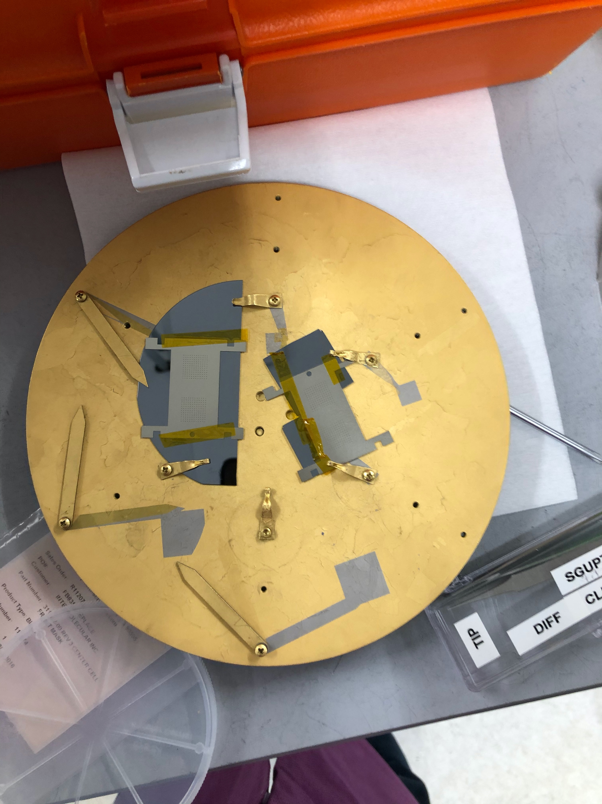
Detailed Si Seed Layer Process Flow
Measure native oxide thickness with Woollam
Use Si, NTVE_OX (fit, guess 15A)
Use AJA to deposit seed layer using Al_0.5A/s recipe
Measure seed layer thickness with Woollam
Use Si, NTVE_OX (prev. meas. value), dielectr/Alumina (fit, guess seed layer thickness)
Seed layer always produces larger thicknesses than expected (poor oxide quality?)
If MSE > 5, fit (n,k) and retry
Use Fiji1/2 to deposit necessary alumina with standard thermal alumina recipe (~1A/cyc)
For MOSCAP, we used measured seed layer thickness values to determine how much to deposit
For MIMCAP, we used constant 50 or 100 cycles across all samples regardless of seed thickness
Measure final thickness with Woollam
Use Si, NTVE_OX (prev. meas. value), dielectr/Alumina (fit, guess seed layer thickness)
If MSE > 5, fit (n,k) and retry
Use AJA to deposit Ti/Au top contact
Use Kapton tape to stick a shadow mask with 200-micron diameter holes to one or more samples
Run Ti 0.5A/s recipe for a final thickness of 5 nm
Run Au 1A/s recipe for a final thickness of 20 nm
Can stick multiple per mask!
Up to 4 possible

Slide 7
Measurement Flow
On Micromanipulator6000: load akashl_E241
Scratch surface to contact substrate
Scratch oriented away from your contacts to minimize dust getting on contacts
Contact SMU1 probe to scratched area
Identify a 3x3 grid of contacts that have no dust
Contact SMU3 probe in top-left corner contact
Breakdown top-left corner structure
Use Backgate Breakdown formula
Bidirectional 0V – 50V sweep (101 steps each way) on SMU3 with 50 mA compliance current
SMU1 grounded, SMU4 floated
Advantage: now backgate contact is physically closer to structures being tested
Less IR drop through substrate
Contact SMU4 to 3 closest contacts for C-V
See gray area in figure on right
Use C-V Sweep formula
Bidirectional -1V – 1V sweep (101 steps each way), measuring Rs-Cs b/w SMU3 and SMU4, no delay, 50 mA AC signal
1kHz, 10kHz, 100kHz, 1MHz, 5MHz measured C-V frequencies
SMU1 floated
Contact SMU4 to 5 remaining outer contacts for breakdown measurements (I-V)
Use Breakdown formula
Unidirectional 0V – 50V sweep (101 steps) on SMU4
50 mA compliance current
SMU1/SMU4 grounded
SMU1
SMU3
SMU4

Slide 8
Breakdown I-V Curve Example (MIM)
Variation in hard breakdown voltage
Low resistivity: sharp breakdown
Very consistent pre-breakdown behavior!

Slide 9
Breakdown I-V Curve Example (MOS)
Variation in hard breakdown voltage
Higher resistivity: slower breakdown
Some sort of leakage? Probe-related?

Slide 10
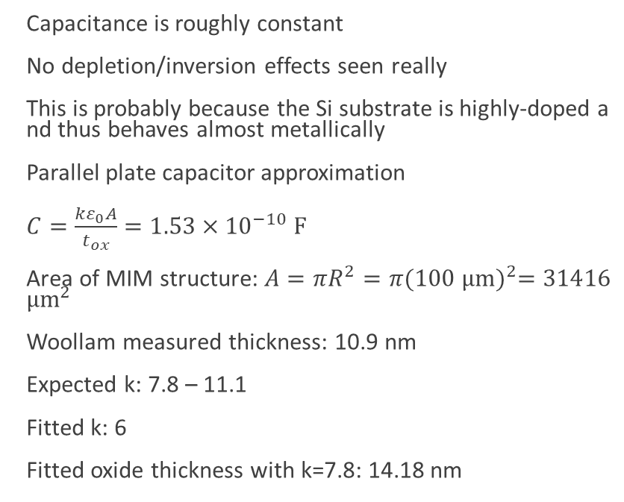
MIM: C-V Curve Example
Capacitance is roughly constant
No depletion/inversion effects seen really
This is probably because the Si substrate is highly-doped and thus behaves almost metallically
Parallel plate capacitor approximation
$C=\frac{kε_{0}A}{t_{ox}}=1.53×{10}^{−10} F$
Area of MIM structure: $A=πR^{2}=π{(100 μm)}^{2}=31416$ $μm^{2}$
Woollam measured thickness: 10.9 nm
Expected k: 7.8 – 11.1
Fitted k: 6
Fitted oxide thickness with k=7.8: 14.18 nm

Slide 11
MOS: C-V Curve Examples
Low-Freq.:
Inversion
Depletion
Accumulation
Hi-Freq.:
Deep Depletion

Slide 12
MOS: C-V Curves (Possible Soft Breakdown)

Slide 13
Measured vs. Target Seed Layer Thickness

Slide 14
ALD Thickness vs. Cycles (MOS/MIM)

Slide 15
Abs. Breakdown Voltage vs. Thickness
Breakdown voltage is defined as 1st intersection of I-V curve with 1mA current threshold

Slide 16
Capacitance vs. Thickness
Capacitance is extracted from low-frequency (1kHz) C-V curve @ 1V

Slide 17
Norm. Breakdown vs. Seed Thickness
Note: # of ALD cycles was NOT dependent on seed thickness here
Note: # of ALD cycles WAS dependent on seed
thickness here

Slide 18
Dielectric Constant vs. Seed Thickness

Slide 19
Carrier Conc. vs. Seed Thickness

Slide 20
MoS₂ seeding
Thickness, imaging, roughness

Slide 21
Oxidized Al thickness
Total target thickness: 5, 10nm
ALD on seed layer deposited MoS2 samples based on table below
Seed layer | 0.5nm |  | 1nm |  | 1.5nm |  | 2nm
After Oxidized | 1.00 | 1.02 | 1.76 | 1.79 | 2.72 | 2.59 | 3.75 | 3.87
After Oxidized | 1.01nm |  | 1.77nm |  | 2.65nm |  | 3.81nm

Slide 22
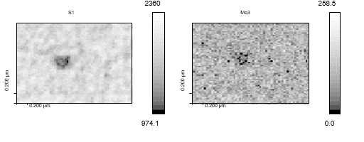
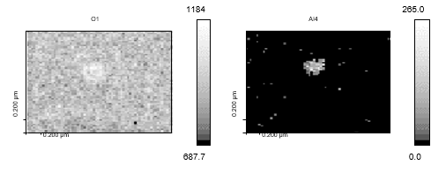
Auger Imaging (5nm w/o seed, 2um view)

Slide 23
AFM images (zoomed in – 500nm)
0.5nm
1nm
1.5nm
2nm

Slide 24
Seed layer on 2D
Using AJA Al dep rate: 0.2Å/s
Large area view: 5um^2
Small area view: 500nm^2
Roughness(nm) | 1 |  | 2 |  | 3 |  | Average
Al | large | small | large | small | large | small | large | small
0nm |  |  |  |  |  |  |  | 0.2nm
0.5nm | 0.19 | 0.16 | 0.33 | 0.19 | 0.31 | 0.20 | 0.27 | 0.18
1nm | 0.88 | 0.61 | 0.91 | 0.45 | 0.96 | 1.06 | 0.92 | 0.71
1.5nm | 1.50 | 0.50 | 0.54 | 0.63 | 0.71 | 0.31 | 0.92 | 0.48
2nm | 1.54 | 0.57 | 1.06 | 0.68 | 1.14 | 0.79 | 1.25 | 0.68

Slide 25
AFM images
Total 5nm w/o seed
Total 10nm w/o seed
Total 10nm w/ seed(2nm)
Scan Area (500nm^2) | Total 5nm | Total 10nm | Total 10nm (2nm)
Roughness (nm) | 1.036 | 0.914 | 0.602

Slide 26
AFM data
Thicker seed layer → rougher surface
With seed layer, roughness decreases
Thought: Seed layer makes more nucleation sites
More will be done with other seed layer thicknesses

Slide 27
Process Flow

Slide 28
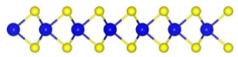
Seed Layer on MoS2
SEM, AFM
Seed layer
Oxidized seed layer
SiO2
AJA
SiO2
Air
SiO2
Si
Si
Si
Metal Oxide
Oxidized seed layer
Oxidized Seed layer
SEM, AFM
SiO2
ALD
SiO2
SEM, AFM, CV
Iteration with more samples
Si
Si

Slide 29
Device Process for I-V measurement
Thermal SiO2 (90nm) on Si
CVD grown MoS2
Spincoat (headway2)
Litho and develop (Heidelberg, headway2)
Seed layer deposition Al||Hf (AJA)
ALD
Gate electrode Ti/Au (AJA)
Liftoff
Process 3, 4 again
Top electrode Ti/Au (AJA)
Liftoff
I-V measurement
Concerns:
Residues (PR) may be present at the surface
Time consuming process
Will verify how long to expect before winter

Slide 30
Possible Project Pivot for Q2: RRAM
Was some interest in this earlier from several research groups at Stanford
Based on similar structures to the MIM ones we have been studying
Just need to add TiN top contacts ☺
Could characterize different resistive switching ALD thin films for reference for Stanford groups
Examples: zirconia, hafnia, alumina, AlN, tantala etc.
Could optimize for different figures of merit and try to develop SOP for RRAM fab

Slide 31
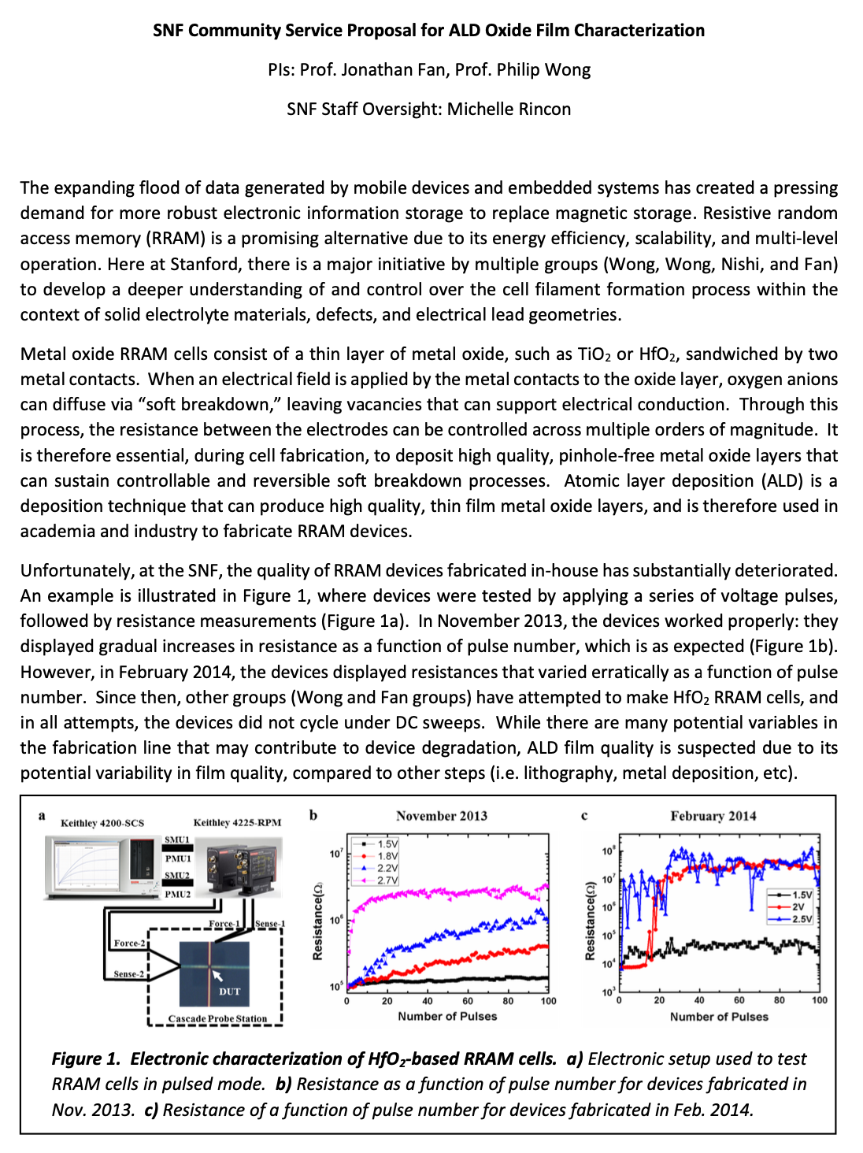
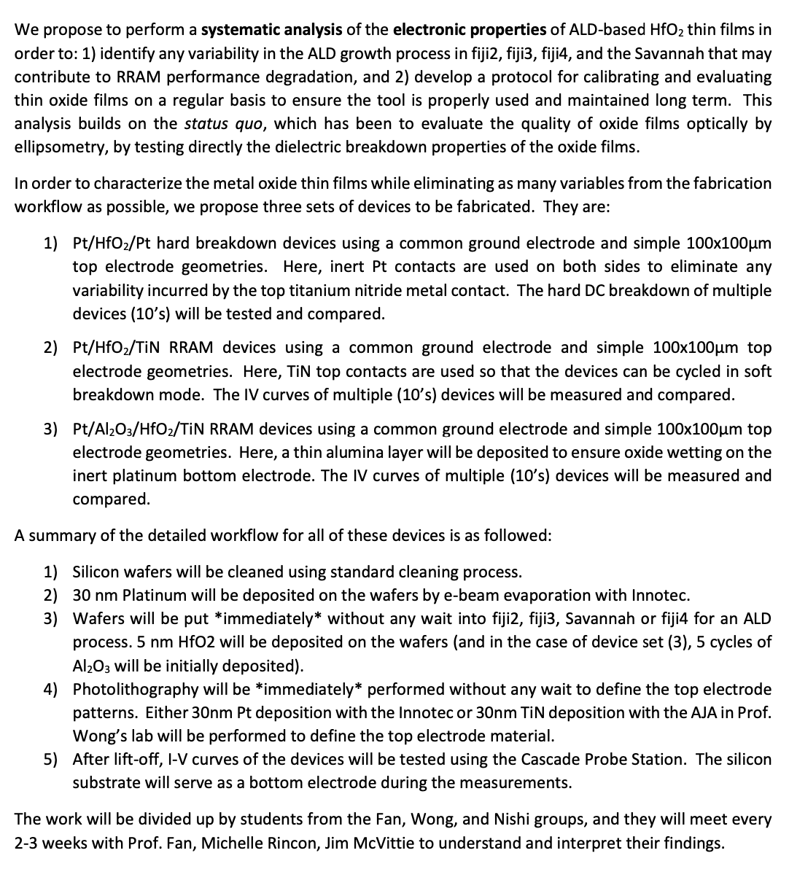
Possible Project Pivot for Q2: RRAM

